Slide 1
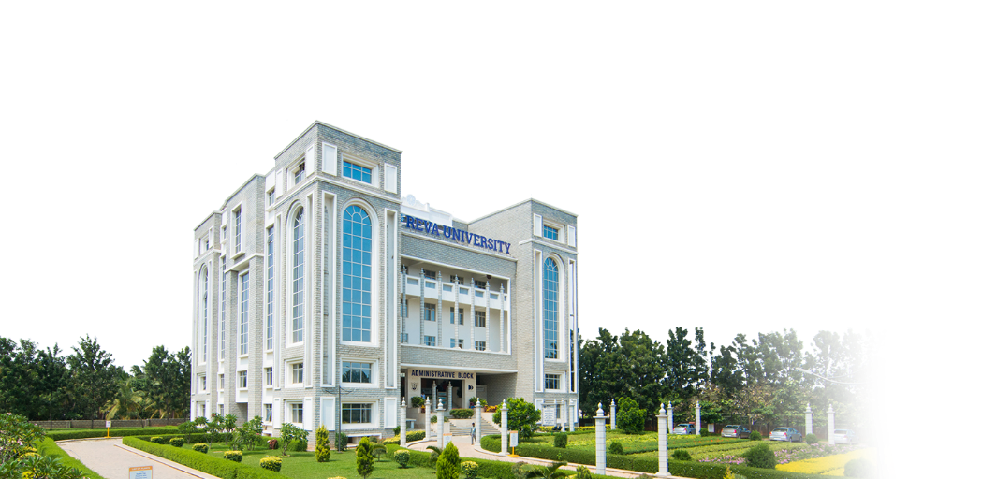
RACE
M.Tech/MS (AI)
Milind Venkatesh Rotti
Music Recommender Data Pre Processing

Slide 2
Content
Using Chinook DB to identify data tables
Joining tables for the final dataset
Data cleaning and processing

Slide 3
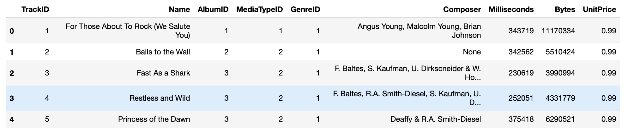
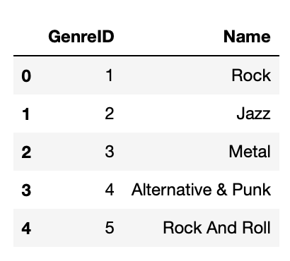
Using Chinook DB to identify data tables
We are using the tracks and genres tables to find out the name of the track and which genre it belongs to
Tracks table Genres table

Slide 4
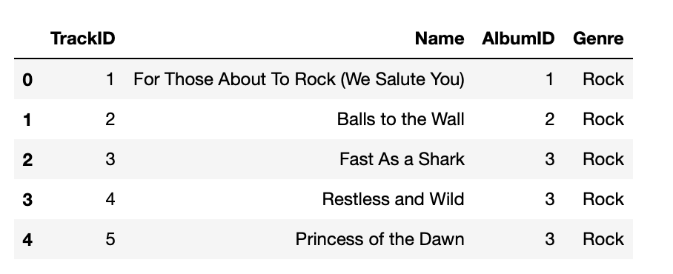
Merging tables for the final dataset
Inner joining tracks and genres table on genre id
Data saved in table named ‘Milind’ in chinook DB

Slide 5
Data cleaning
Check and make sure there are no null records.
No null records for genre name found. Data is clean.

